Slide 1


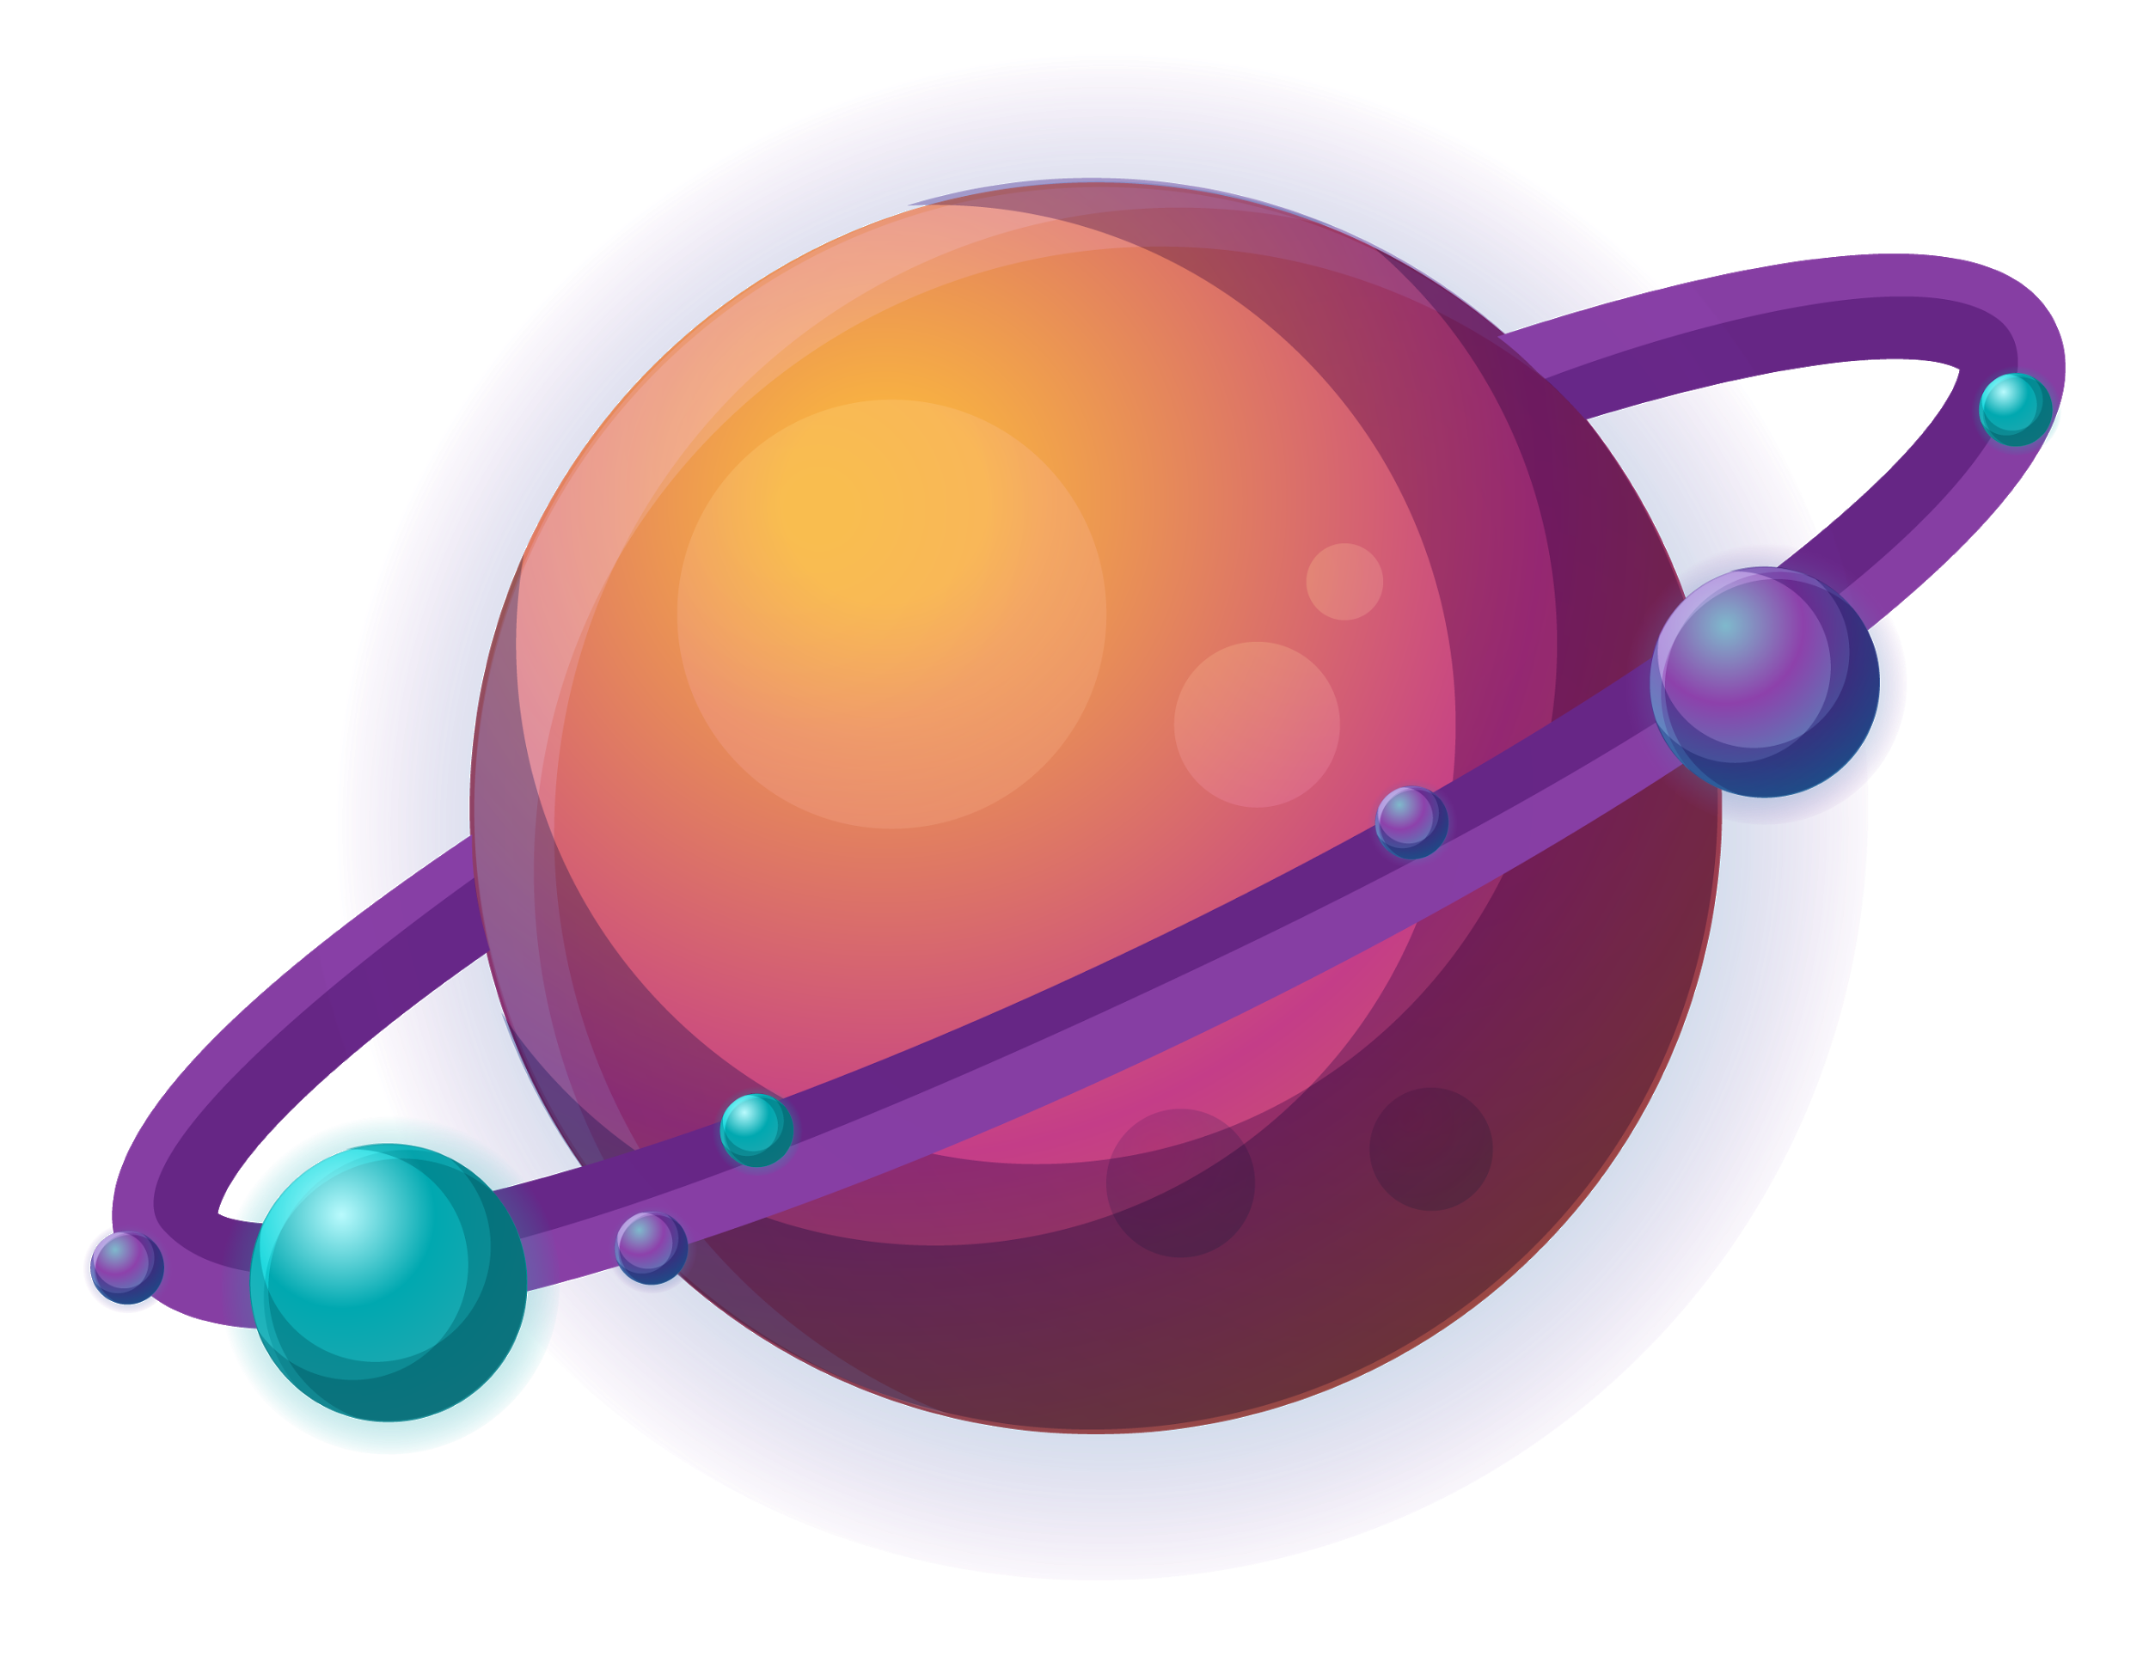




L a téléportation quantique
Est_elle possible aujourd’hui?
Réalisé par Samar Lassoued

Slide 2
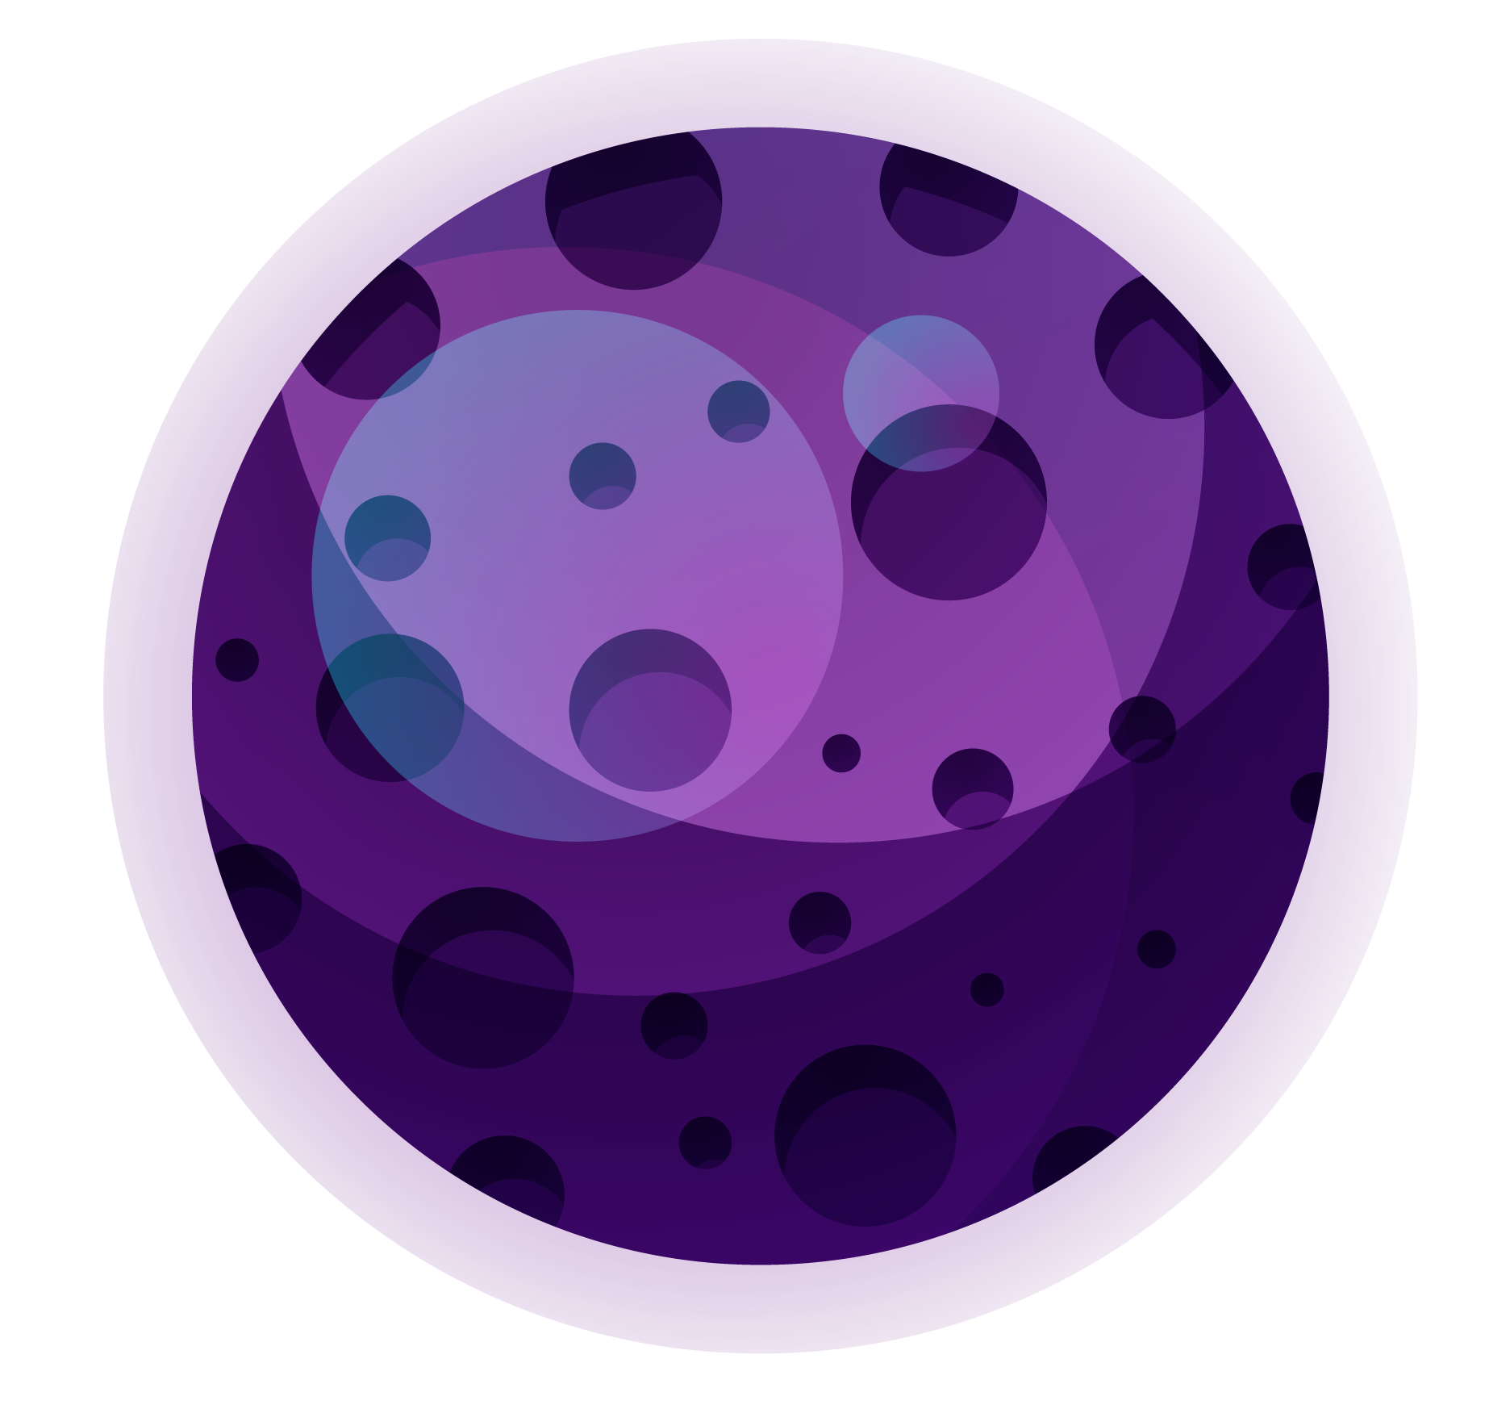

BoB
Alice
Etat de BELL:
1/ √ 2 (|00> + |11>)
|ψ>=α|0>+β|1>
|ψ>=α|0>+β|1>
Comment????
Despno

Slide 3



ON va créer l’état de Bell partagé entre Alice et Bob
|0>
H
01
|0>
CNOT
1/√ 2 (|0>+|1>) *|0>= 1/√ 2|00>+ 1/√ 2|10>
1/√ 2|00>+ 1/√ 2|11>

Slide 4
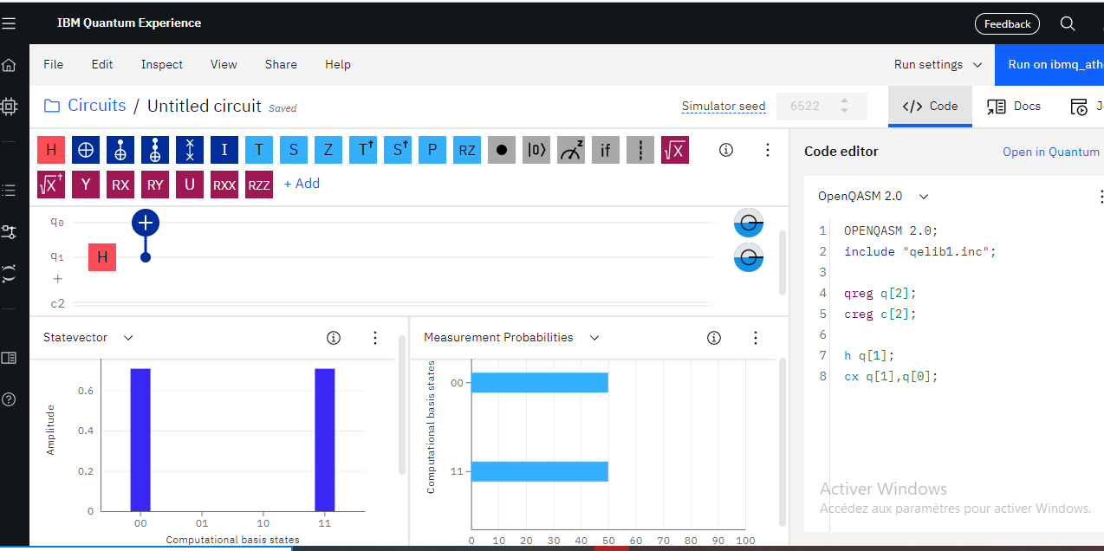
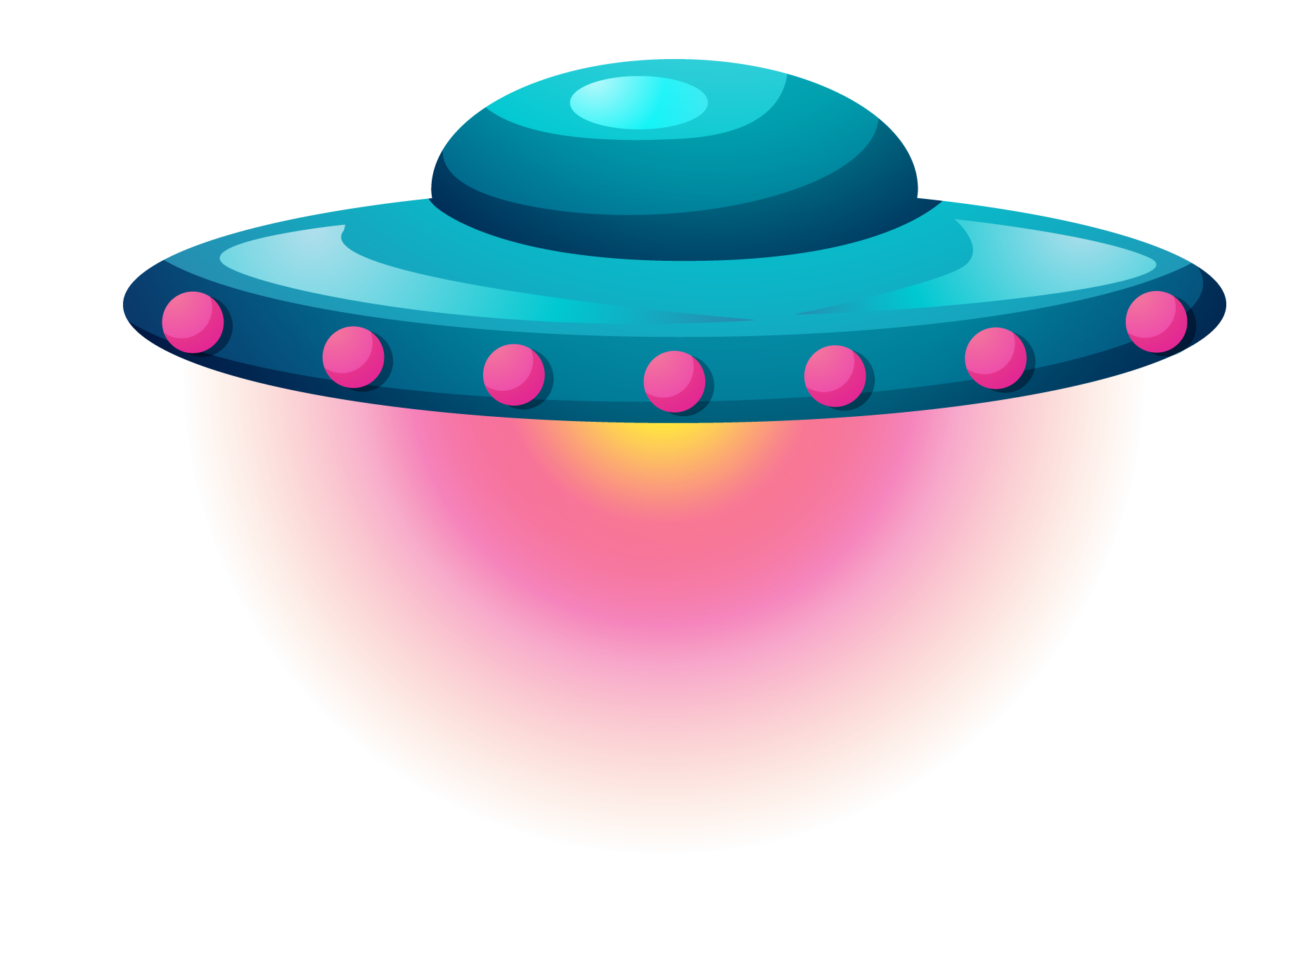
WHOA!
It could be the part of the presentation where you can introduce yourself, write your email…

Slide 5
2) Le circuit qui permet de téléporter un état quantique quelconque entre Alice et Bob est le suivant:
|0>
CNOT
X
z
zx
|0>
H
Mesure
H
|ψ>
CNOT
Mesure
|ψ1>
|ψ2>
|ψ3>

Slide 6
|ψ1>=1/√ 2(|00>+ |11>)(α|0> +β|1>)
=1/√ 2(α |0>|0>|0>+β|0>|0>|1>+ α |1> |1>|0>+β |1> |1> |1>)
CNOT
|ψ2>= 1/√ 2(α |0>|0>|0>+ β|0>|0>|1>+ α|1>|1>|1>+β |1>|1> |0>)
=|0>(|0>(α |0>|+ β|1>) / √ 2)+|1>(|1> (|1>(α |1>+ β |0>) / √ 2)
HADAMARD
|ψ3>= |0>((|0>+ |1>)/√ 2(α |0>|+ β|1>)/ √ 2)+ |1>(|0>-|1>)/√ 2(α |1>+ β |0>) / √ 2)
|ψ3>=1/2[α|000>+ β|001>+ α |010>+ β |011>+ α |101>+ β |100>- α |111>- β |110>]
|ψ3>=1/2[(α|0b> +β|1b>)|00>+(β|0b>+α|1b>)|01>+ (α|0b>β|1b>)|10>+(β|0b>- α|1b> )|11>

Slide 7
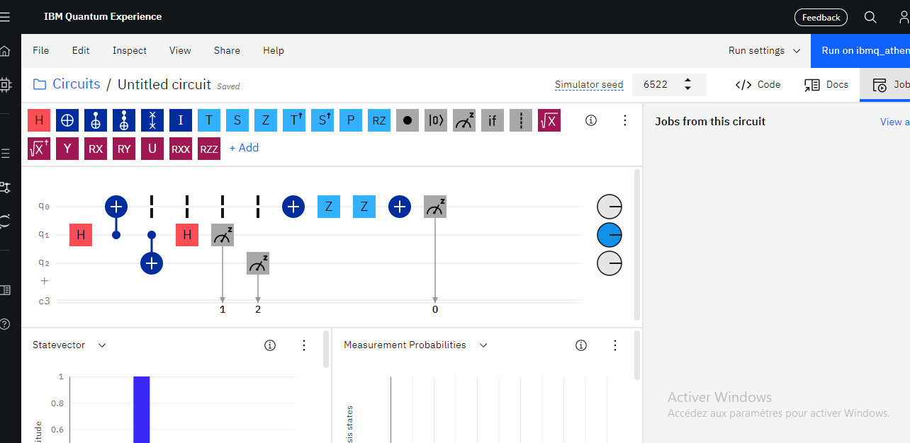
HOW ABOUT THESE TWO CONCEPTS?
Mercury
Venus
Mercury is the closest planet to the Sun and the smallest one in the Solar System—it’s only a bit larger than our Moon
Venus has a beautiful name and is the second planet from the Sun. It’s terribly hot—even hotter than Mercury

Slide 8
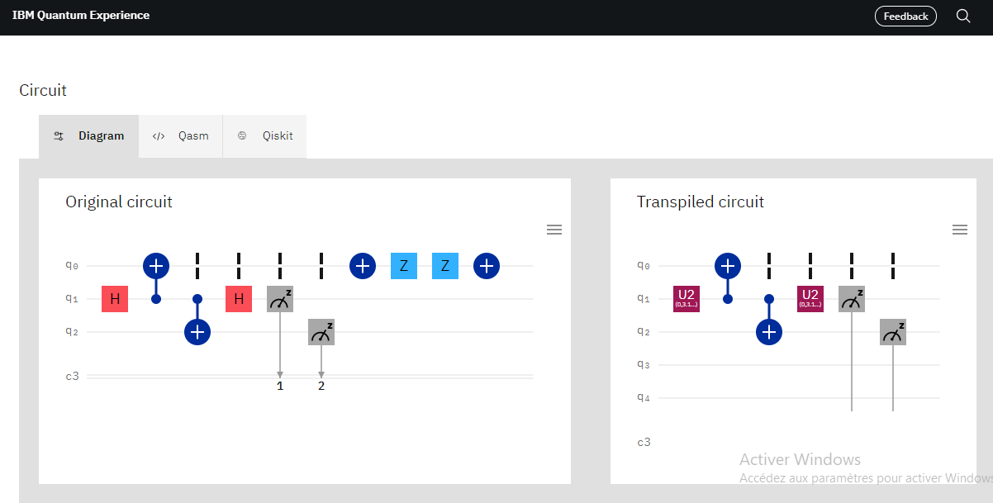
THE SLIDE TITLE GOES HERE!

Slide 9

On a maintenant le nouveau état |ψ>= √ 3/2 |0> + 1/2 |1>
α=cos(θ/2)= √ 3/2 θ=pi/3 , pi/2<θ<pi/2
Φ=0
β=1/2= sin(θ/2) exp(i ϕ)

Slide 10
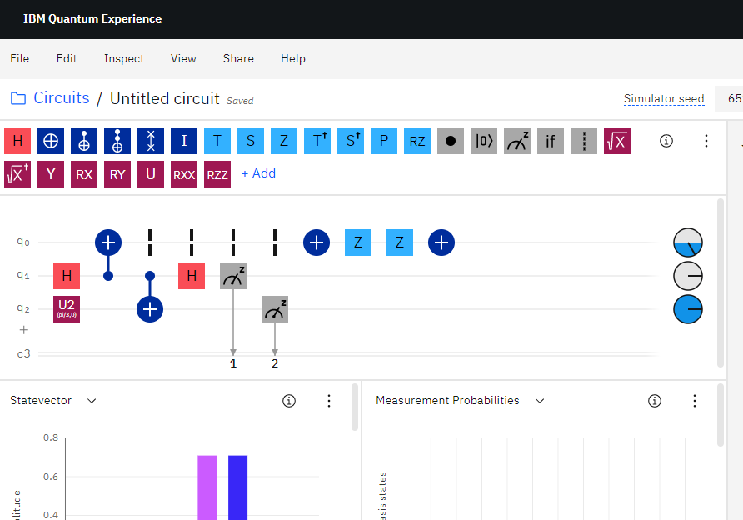
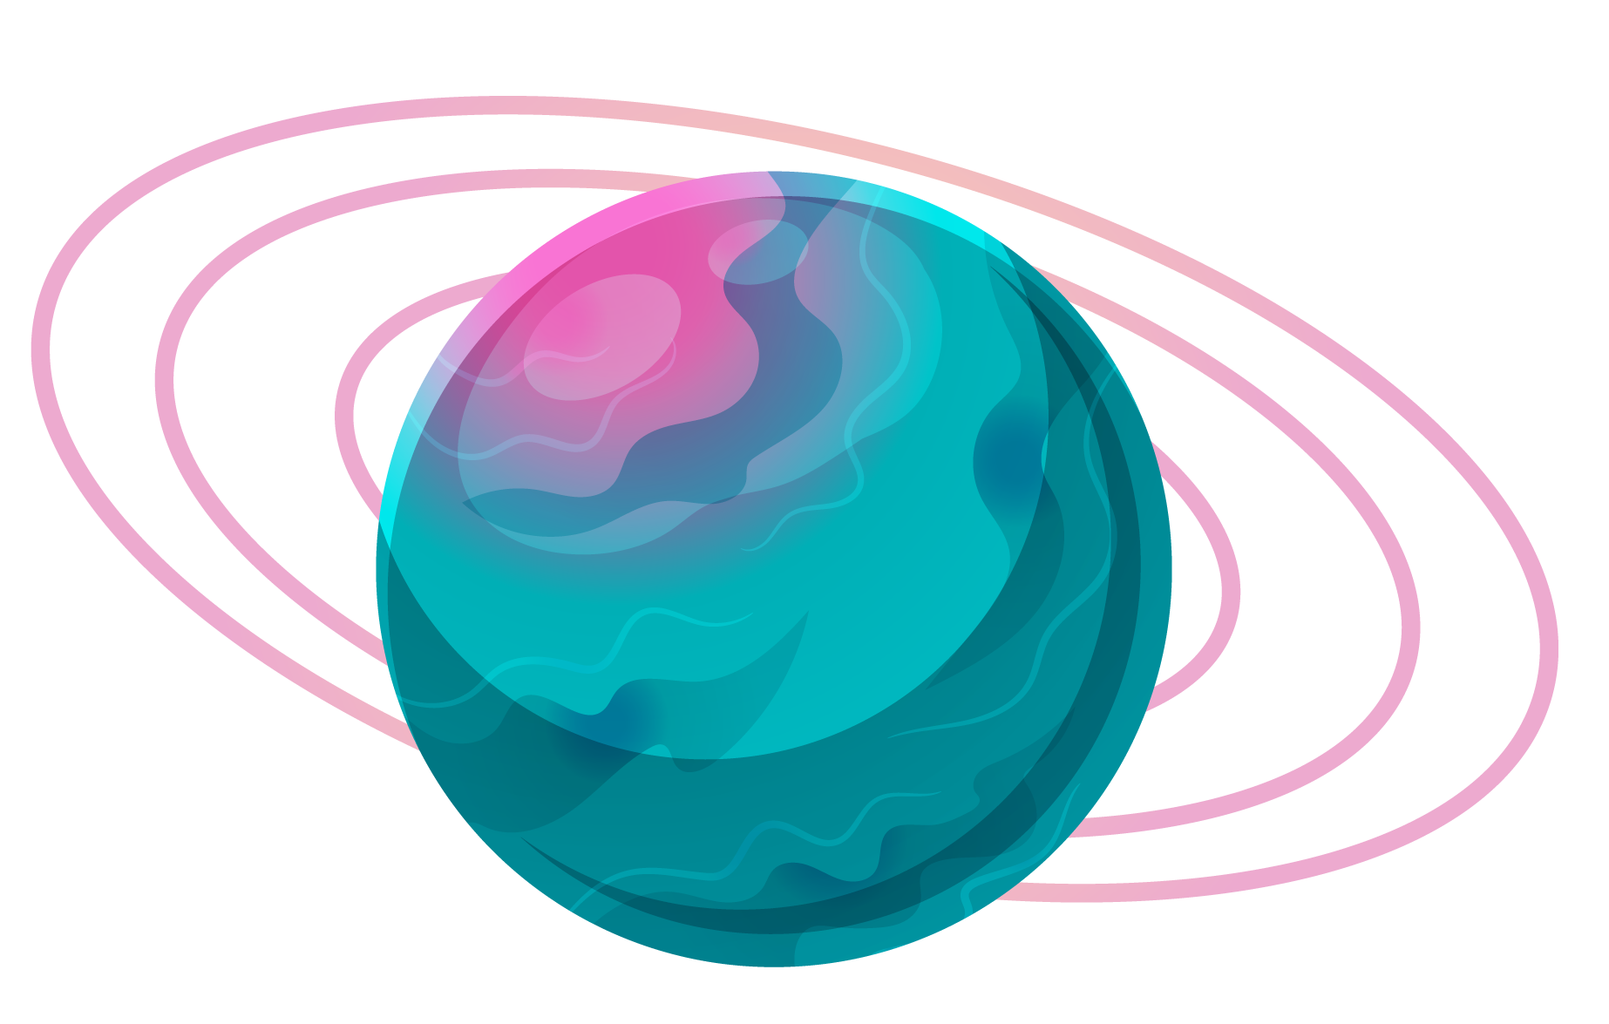
SECTION
02
This is the subtitle that makes it comprehensible

Slide 11
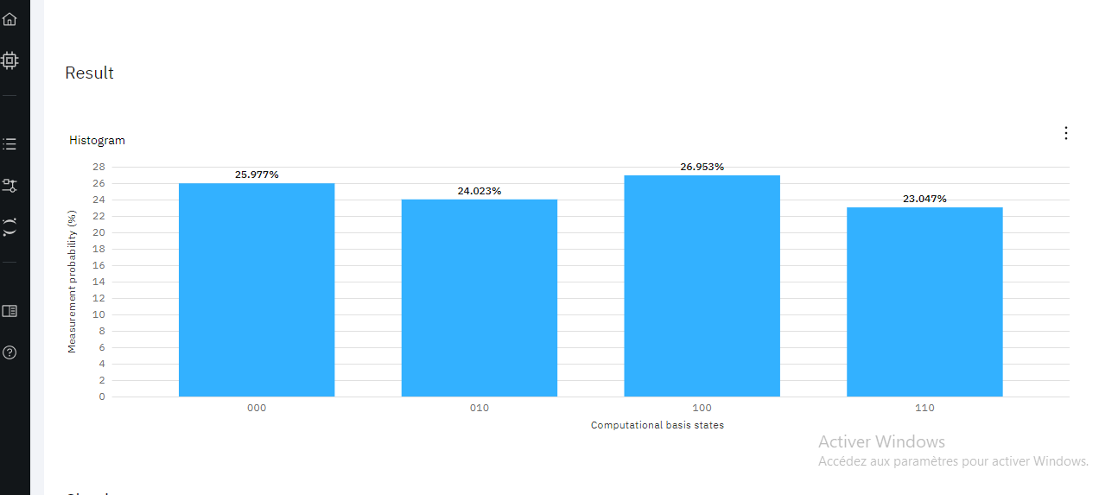


Conclusion

Slide 12

AN IMAGE IS WORTH A THOUSAND WORDS

Slide 13

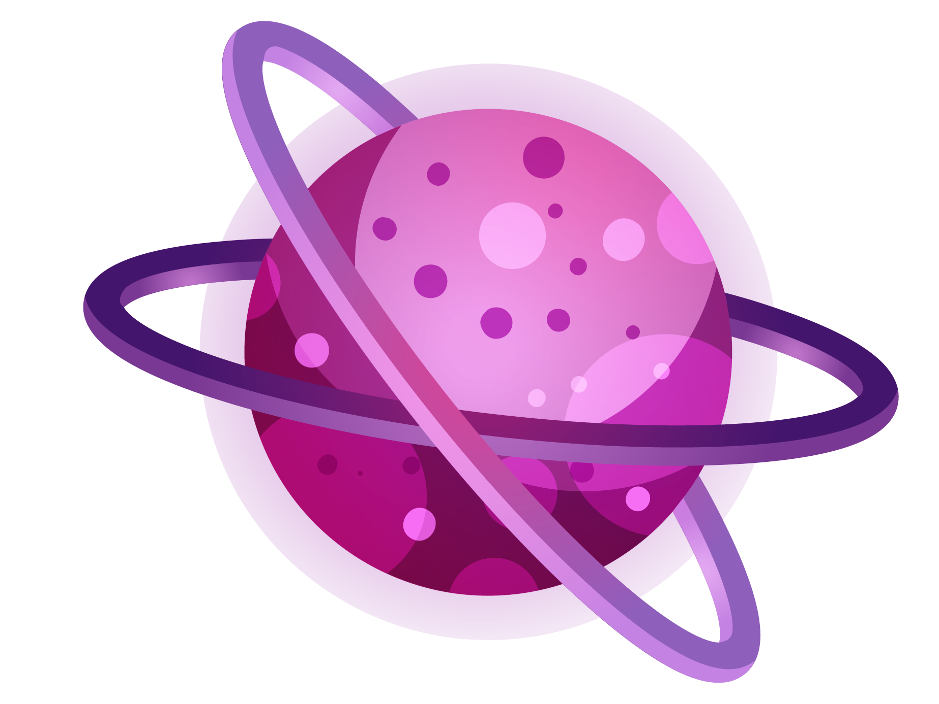
A TIMELINE ALWAYS WORKS FINE
Day 1
Day 3
Mercury is the closest planet to the Sun
Despite being red, Mars is a cold place, not hot
Day 2
Day 4
Venus has a beautiful name, but it’s terribly hot
It’s the biggest planet in our Solar System

